Slide 1
Decoder matters for dense prediction problems -The Devil is in the Decoder -
2017. 09. 15
Minkyu Lee

Slide 2
Introduction
2
1
Decoder matters for dense prediction problems -The Devil is in the Decoder -
3
Notes:
개념 설명
Dense prediction
Decoder matters
Paper – The Devil is in the Decoder

Slide 3
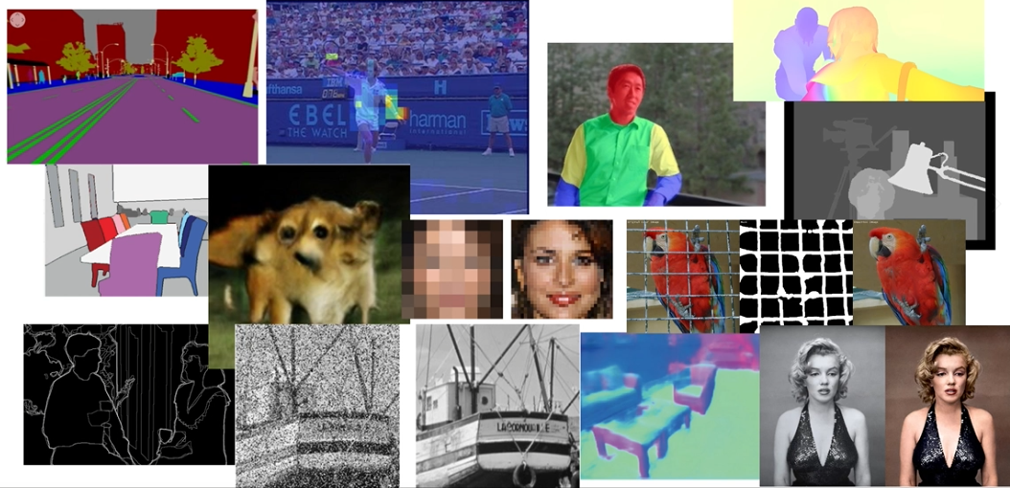
Introduction
Dense prediction problems
Notes:
추정해야 하는 결과가 image 단위가 되는 문제
Labeling, Disparity estimation, Super-resolution, Segmentation, Colorization, Image Restoration

Slide 4
Introduction
2
1
Decoder matters for dense prediction problems -The Devil is in the Decoder -
3
Notes:
개념 설명
Dense prediction
Decoder matters
Paper – The Devil is in the Decoder

Slide 5
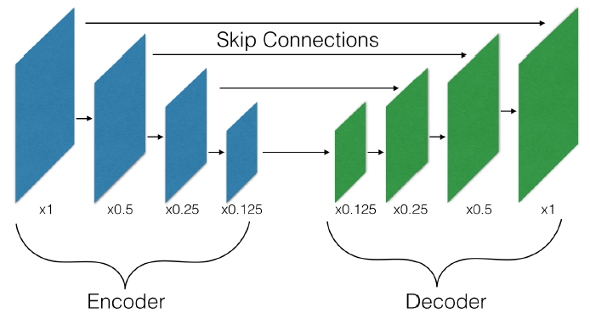
Introduction
Encoder-decoder architecture used for dense prediction problems
A encoder downsamples the spatial resolution while increasing the number of channels
A decoder upsamples the representation back to the original input size
Dense prediction problems
Semantic Segmentation
Super-resolution
Colorization
Depth estimation
Optical flows
Notes:
Encoder, Decoder 역할 설명

Slide 6

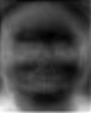
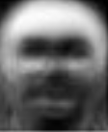
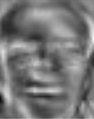
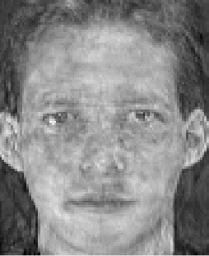
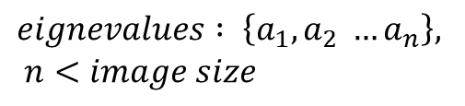
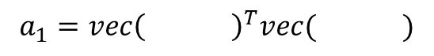
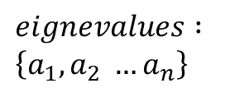
Introduction
Encoder vs. Decoder in the computer vision.
Encoder ( Feature Extraction )
Decrease spatial resolution while learning high-dimensional representation.
Decoder
Recovers the original input resolution.
Linear subspace projection ( Encoder )
400 eigenvalues
$$eignevalues : \left\{a_{1}, a_{2} …a_{n}\right\}, \\ n<image size$$
Original Image
…
$$a_{1}=vec{\left( \right)}^{T}vec( )$$
92x112 = 10304 pixels
Eigenfaces ( kernels )
400 eigenvectors
Reconstruction ( Decoder )
$$eignevalues : \\ \left\{a_{1}, a_{2} …a_{n}\right\}$$
…
Reconstructed Image
Eigenfaces ( kernels )
Notes:
PCA feature 기반으로 encoder와 decoder의 동작 설명

Slide 7
Introduction
2
1
Decoder matters for dense prediction problems -The Devil is in the Decoder -
3
Notes:
개념 설명
Dense prediction
Decoder matters
Paper – The Devil is in the Decoder

Slide 8
Introduction
What’s meaning of “The Devil is in the Decoder ^{[1]} ”.
It’s derived from the Idiom
Idiom : Devils are in the details.
Meaning : Plans, actions, or situations that seem sound must be carefully examined, because minor details can end up causing major, unforeseen problems.
[1] Wojna, Zbigniew, et al. "The Devil is in the Decoder.“, British Machine Vision Conference 2017.
Notes:
겉보기에 좋은 작품이라도 하나하 보면 악마가 숨어있다. 즉 헛점이 있기 마련이다.
작은 헛점 때문에 일을 그르칠 수 있으므로

Slide 9
Introduction
What’s meaning of “The Devil is in the Decoder”.
It’s derived from the Idiom
Idiom : Devils are in the details.
Meaning : Plans, actions, or situations that seem sound must be carefully examined, because minor details can end up causing major, unforeseen problems.
Notes:
Details = Decoder
Dense Prediction Problems문제에 따라서 어떤 Decoder를 쓰느냐에 따라 결과가 달라질 수 있음.

Slide 10
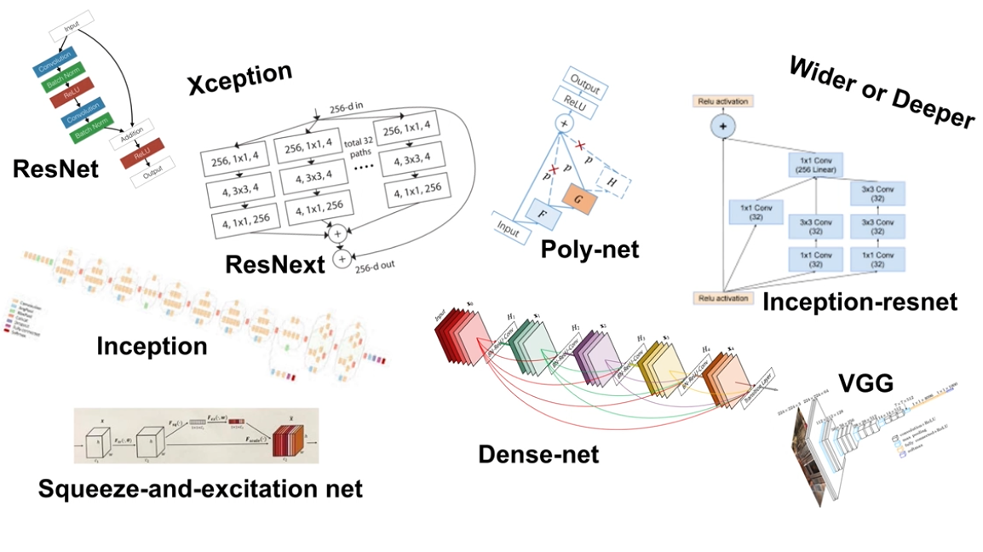
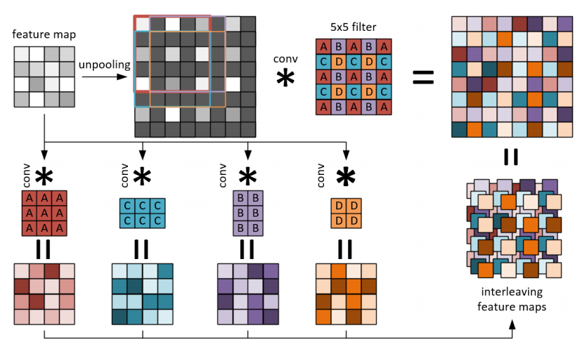
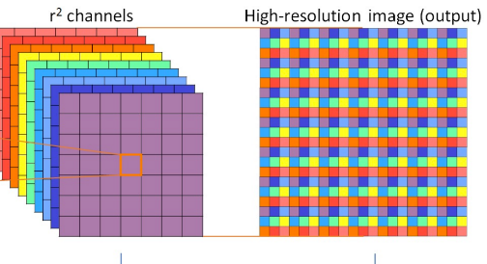
Introduction
Encoders are well studied but decoders not much
Encoders
Decoders
up convolution
Sub-pixel convolution
Notes:
Decoder들에 대한 연구는 많이 진행되지 않았음.

Slide 11
Introduction
Contents
Observe significant variance in results between different types of decoders on various problems
Introduce a new bilinear additive upsampling layer
Introduce residual-like connections for decoder
Notes:
다양한 종류의 Decoder
Bilinear additive upsampling layer 소개
Residual-like connection 소개

Slide 12
Methods
Types of decoders
Convolution
Transposed Convolution
Decomposed Transposed Convolution
Separable Transposed Convolution
Depth To Space ( Sub-pixel Convolution )
Bilinear Upsampling
Bilinear Additive Upsampling

Slide 13
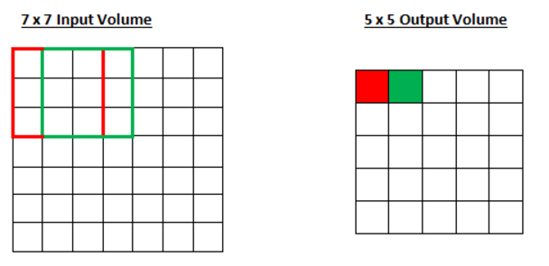
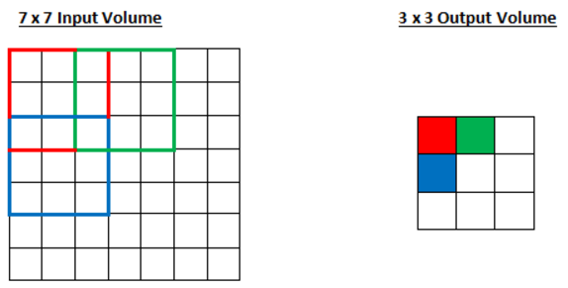
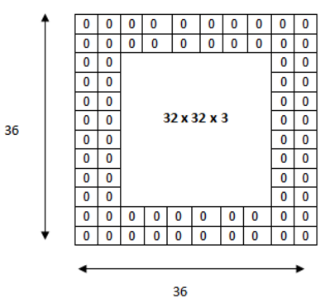
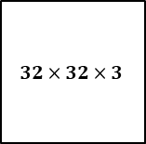
Methods
Convolution ^{[2]}
Convolution parameters in convolutional neural network.
Stride
How the filter convolves around the input volume.
Control speed and memory requirements.
Padding
Pad the input volume with zeros around the border.
Keep output size same as input size.
[ Stride = 1 ]
[ Stride = 2 ]
Input Volume
Output Volume
$$32×32×3$$
[2] Dumoulin, Vincent, and Francesco Visin. "A guide to convolution arithmetic for deep learning." arXiv preprint arXiv:1603.07285 (2016).
Notes:
Decoder의 Convolution을 이해하기 위한 용어 소개
Stride
동작 : stride 단위마다 pixel을 뛰어넘어서 convolution 연산을 수행하는 것
목적 : 메모리 효율 증대 및 속도 향상
Padding
동작 : 영상 주변을 0으로 채워 넣는것
목적 : 영상의 사이즈를 유지하기 위함

Slide 14
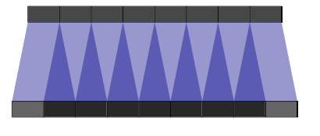
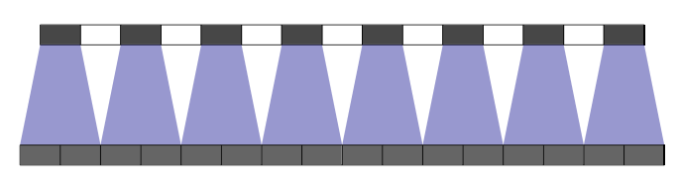
Methods
Convolution
Convolution at up-sampling
Stride = 1, kernel size = 2
Stride = 2, kernel size = 2
Input layer with size 7
Output layer with size 9
Input layer with size 7
Output layer with size 14
Notes:
Stride와 kernel 크기에 따라 output layer의 크기가 결정되는 예시

Slide 15
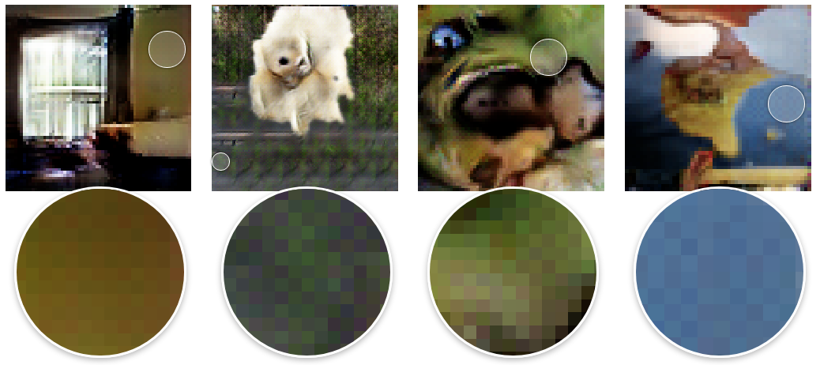


Methods
Convolution
Checkerboard Artifact ^{[3]}
$$≈$$
[3] Odena, Augustus, Vincent Dumoulin, and Chris Olah. "Deconvolution and checkerboard artifacts." Distill 1.10 (2016): e3.
Notes:
CNN에서 Deconvolution 문제 – super-resolution 결과

Slide 16
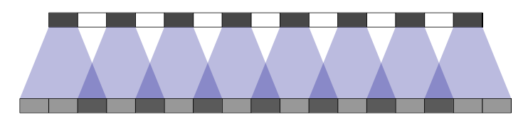
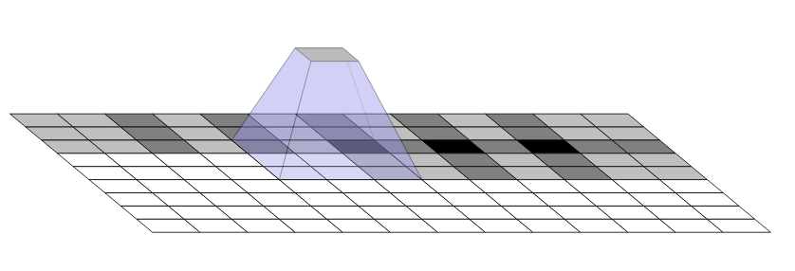
Methods
Convolution
Checkerboard Artifact
Deconvolution can easily have uneven overlap.
Ex) Stride = 2, kernel size = 3
In two dimensional image, the deconvolution has some outputs with four times the number of inputs as others.
Notes:
Uneven overlap으로 인한 데이터의 분포의 불균형
1D에서는 2배
2D에서는 4배

Slide 17
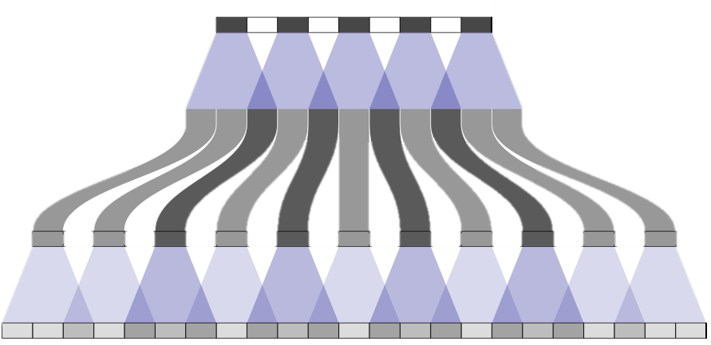
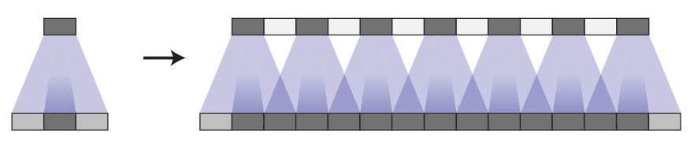
Methods
Convolution
Checkerboard Artifact
Uneven overlap in multiple layers of deconvolution
Tricky Solution : Balancing with stride and kernel size
Notes:
Neural Network의 경우 여러 개의 레이어가 연결되어 있으므로 이러한 문제가 다른 레이어로 퍼져나가게 됨.
Tricky solution으로 stride를 동등하게 겹치도록
Kernel의 형태에 자유도가 너무 높음 → overfitting 문제

Slide 18
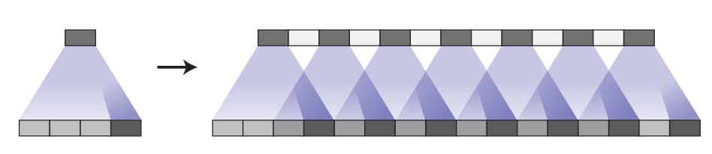
Methods
Convolution
Checkerboard Artifact
Uneven overlap caused by Model
Notes:
Kernel 값의 Bias 문제도 여전히 있음

Slide 19
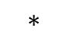
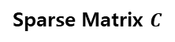
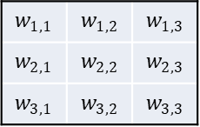
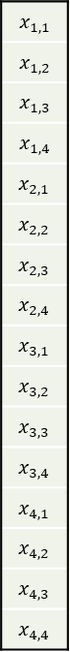
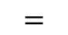
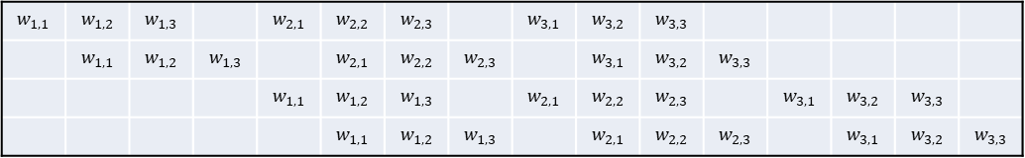
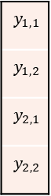
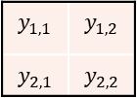

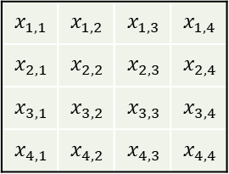
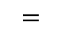
Methods
Transposed Convolution
Convolution Operation
$$w_{1,1}$$ | $$w_{1,2}$$ | $$w_{1,3}$$
$$w_{2,1}$$ | $$w_{2,2}$$ | $$w_{2,3}$$
$$w_{3,1}$$ | $$w_{3,2}$$ | $$w_{3,3}$$
$$x_{1,1}$$ | $$x_{1,2}$$ | $$x_{1,3}$$ | $$x_{1,4}$$
$$x_{2,1}$$ | $$x_{2,2}$$ | $$x_{2,3}$$ | $$x_{2,4}$$
$$x_{3,1}$$ | $$x_{3,2}$$ | $$x_{3,3}$$ | $$x_{3,4}$$
$$x_{4,1}$$ | $$x_{4,2}$$ | $$x_{4,3}$$ | $$x_{4,4}$$
$$∗$$
$$y_{1,1}$$ | $$y_{1,2}$$
$$y_{2,1}$$ | $$y_{2,2}$$
$$=$$
$$x_{1,1}$$
$$x_{1,2}$$
$$x_{1,3}$$
$$x_{1,4}$$
$$x_{2,1}$$
$$x_{2,2}$$
$$x_{2,3}$$
$$x_{2,4}$$
$$x_{3,1}$$
$$x_{3,2}$$
$$x_{3,3}$$
$$x_{3,4}$$
$$x_{4,1}$$
$$x_{4,2}$$
$$x_{4,3}$$
$$x_{4,4}$$
$$y_{1,1}$$
$$y_{1,2}$$
$$y_{2,1}$$
$$y_{2,2}$$
$$w_{1,1}$$ | $$w_{1,2}$$ | $$w_{1,3}$$ |  | $$w_{2,1}$$ | $$w_{2,2}$$ | $$w_{2,3}$$ |  | $$w_{3,1}$$ | $$w_{3,2}$$ | $$w_{3,3}$$
 | $$w_{1,1}$$ | $$w_{1,2}$$ | $$w_{1,3}$$ |  | $$w_{2,1}$$ | $$w_{2,2}$$ | $$w_{2,3}$$ |  | $$w_{3,1}$$ | $$w_{3,2}$$ | $$w_{3,3}$$
 |  |  |  | $$w_{1,1}$$ | $$w_{1,2}$$ | $$w_{1,3}$$ |  | $$w_{2,1}$$ | $$w_{2,2}$$ | $$w_{2,3}$$ |  | $$w_{3,1}$$ | $$w_{3,2}$$ | $$w_{3,3}$$
 |  |  |  |  | $$w_{1,1}$$ | $$w_{1,2}$$ | $$w_{1,3}$$ |  | $$w_{2,1}$$ | $$w_{2,2}$$ | $$w_{2,3}$$ |  | $$w_{3,1}$$ | $$w_{3,2}$$ | $$w_{3,3}$$
$$×$$
$$=$$
Sparse Matrix $C$
Notes:
Convolution operator를 Matrix로 표현

Slide 20
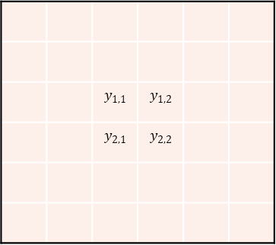
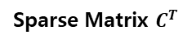
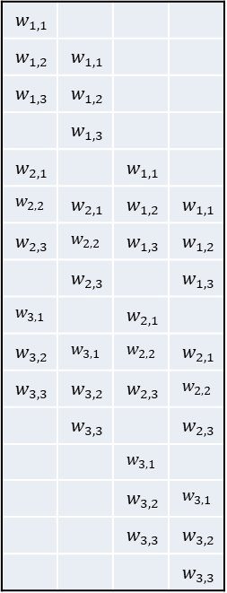
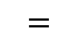
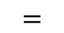
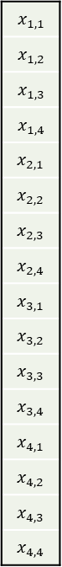
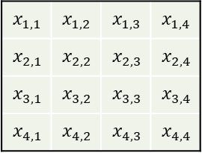


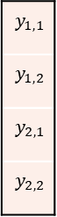
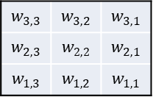
Methods
Transposed Convolution
Transposed Convolution Operation
$$w_{1,1}$$
$$w_{1,2}$$ | $$w_{1,1}$$
$$w_{1,3}$$ | $$w_{1,2}$$
 | $$w_{1,3}$$
$$w_{2,1}$$ |  | $$w_{1,1}$$
$$w_{2,2}$$ | $$w_{2,1}$$ | $$w_{1,2}$$ | $$w_{1,1}$$
$$w_{2,3}$$ | $$w_{2,2}$$ | $$w_{1,3}$$ | $$w_{1,2}$$
 | $$w_{2,3}$$ |  | $$w_{1,3}$$
$$w_{3,1}$$ |  | $$w_{2,1}$$
$$w_{3,2}$$ | $$w_{3,1}$$ | $$w_{2,2}$$ | $$w_{2,1}$$
$$w_{3,3}$$ | $$w_{3,2}$$ | $$w_{2,3}$$ | $$w_{2,2}$$
 | $$w_{3,3}$$ |  | $$w_{2,3}$$
 |  | $$w_{3,1}$$
 |  | $$w_{3,2}$$ | $$w_{3,1}$$
 |  | $$w_{3,3}$$ | $$w_{3,2}$$
 |  |  | $$w_{3,3}$$
$$x_{1,1}$$
$$x_{1,2}$$
$$x_{1,3}$$
$$x_{1,4}$$
$$x_{2,1}$$
$$x_{2,2}$$
$$x_{2,3}$$
$$x_{2,4}$$
$$x_{3,1}$$
$$x_{3,2}$$
$$x_{3,3}$$
$$x_{3,4}$$
$$x_{4,1}$$
$$x_{4,2}$$
$$x_{4,3}$$
$$x_{4,4}$$
 |  | $$y_{1,1}$$ | $$y_{1,2}$$
 |  | $$y_{2,1}$$ | $$y_{2,2}$$
$$y_{1,1}$$
$$y_{1,2}$$
$$y_{2,1}$$
$$y_{2,2}$$
$$w_{3,3}$$ | $$w_{3,2}$$ | $$w_{3,1}$$
$$w_{2,3}$$ | $$w_{2,2}$$ | $$w_{2,1}$$
$$w_{1,3}$$ | $$w_{1,2}$$ | $$w_{1,1}$$
$$∗$$
$$×$$
$$=$$
$$x_{1,1}$$ | $$x_{1,2}$$ | $$x_{1,3}$$ | $$x_{1,4}$$
$$x_{2,1}$$ | $$x_{2,2}$$ | $$x_{2,3}$$ | $$x_{2,4}$$
$$x_{3,1}$$ | $$x_{3,2}$$ | $$x_{3,3}$$ | $$x_{3,4}$$
$$x_{4,1}$$ | $$x_{4,2}$$ | $$x_{4,3}$$ | $$x_{4,4}$$
$$=$$
Sparse Matrix $C^{T}$
Notes:
Transposed Convolution은 kernel을 원점 기준으로 flip하여 사용하는 연산
C가 Orthogonal matrix라 가정하면 Inverse matrix는 이의 transpose가 됨

Slide 21
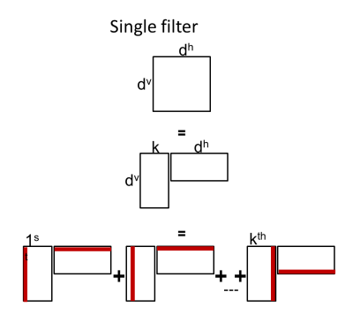

Methods
Decomposed Transposed Convolution
Decomposed Kernel
A 2D filter of rank-k can be represented as the product of two matrices or, alternatively, as the linear combination of the outer product of a set of vectors
Ex) Sobel kernel ^{[4]}
-1 | 0 | 1
-2 | 0 | 2
-1 | 0 | 1
-1
-2
-1
=
$$×$$
1 | 0 | -1
[4] An Introduction to different Types of Convolutions in Deep Learning, https://medium.com/towards-data-science/types-of-convolutions-in-deep-learning-717013397f4d, 2017
Notes:
Transpose convolution 연산의 가속화를 위해 low rank로 kernel을 제약하는 방법

Slide 22
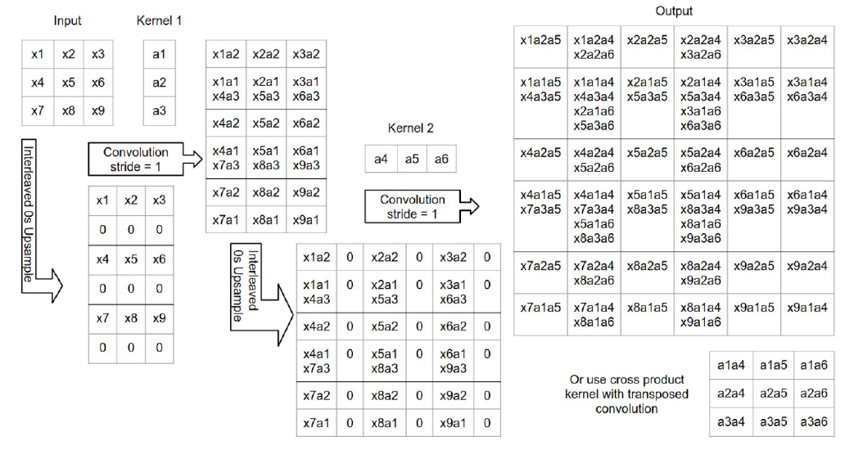
Methods
Decomposed Transposed Convolution
Decomposed Transposed Convolution Operation
Notes:
각 축으로 분할하여 연산하는 것이 훨씬 빠름

Slide 23
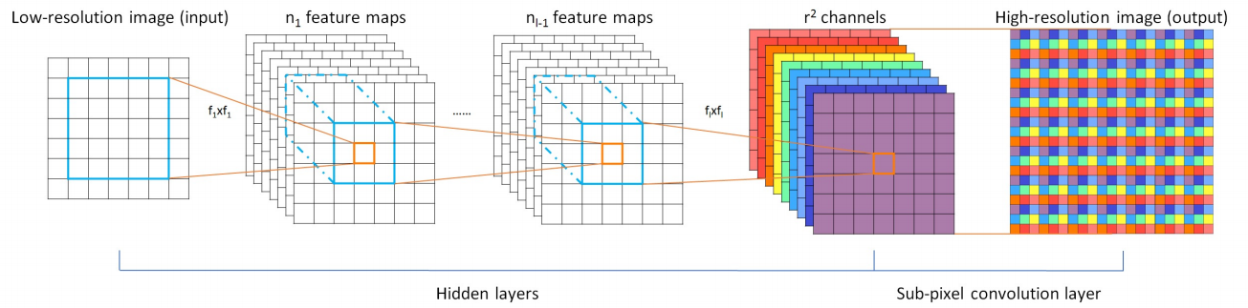
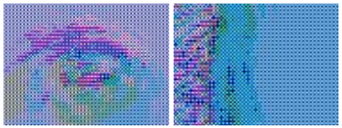
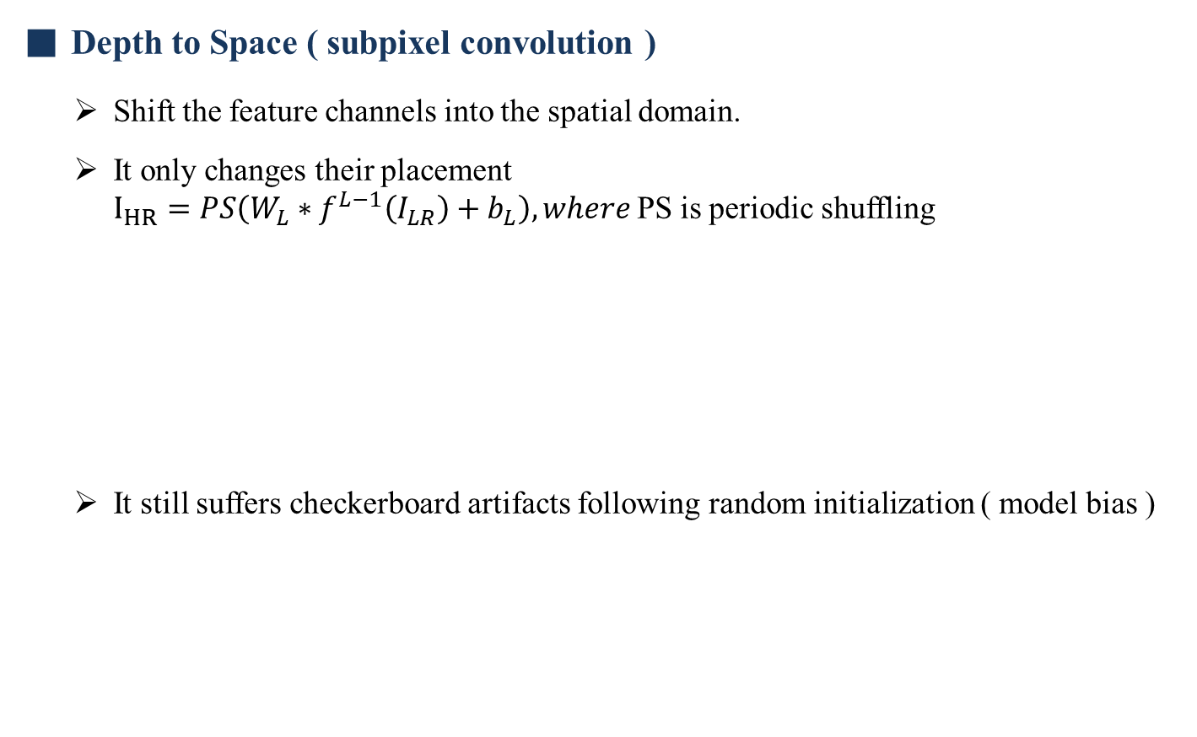
Methods
Depth to Space ( subpixel convolution )
Shift the feature channels into the spatial domain.
It only changes their placement $I_{HR}=PS\left(W_{L}∗f^{L−1}\left(I_{LR}\right)+b_{L}\right), where$PS is periodic shuffling
It still suffers checkerboard artifacts following random initialization ( model bias )
Super-resolution image
Notes:
Layer 를 Balancing을 고려하여 설계하지 않아도 됨

Slide 24
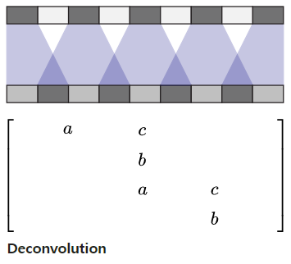
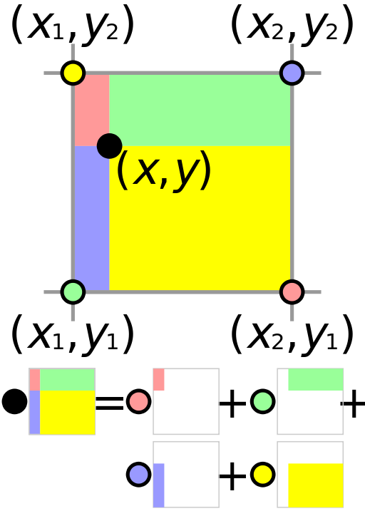

Methods
Resize Convolution
Resize increases the feature size quadraticaly while keeping the same amount of information.
Resize is followed by a convolution.
Deconvolution
Resize
Resize Deconvolution
Notes:
Unbalance를 완화 시켜줌

Slide 25

Methods
Resize Convolution
The checkerboard artifacts tend to be most prominent when outputting unusual colors.
Since neural network layers typically have a bias it’s easy to output the average color. The further a color is away from the average color, the more deconvolution needs to contribute.
Resize convolution is implicitly weighting in a way that discourage high frequency artifacts.
Notes:
Qualitative results

Slide 26


Methods
Bilinear Additive Upsampling ( Proposed )
Bilinear upsampling as before, add every N consecutive channels together
W, H - feature width and height
w, h – kernel width and height
I, O – number of channels for input and output feature
Notes:
연산 과정 및 복잡도
Transpose Convolution과 동일

Slide 27

Methods
Skip Connections and Residual Connections
Skip Connection
It uses feature from the encoder in the decoder part of the same spatial resolution

Slide 28


Methods
Skip Connections and Residual Connections
Residual Connection ^{[5, 6]}
It is a kind of skip connection that bypasses the non-linear transforms with an identity mapping and explicitly reformulates the layers as learning residual functions with reference to the layer input.
Residual connection
[5] He, Kaiming, et al. "Deep residual learning for image recognition." Proceedings of the IEEE conference on computer vision and pattern recognition. 2016.
[6] Yu, Lequan, et al. "Volumetric ConvNets with Mixed Residual Connections for Automated Prostate Segmentation from 3D MR Images." AAAI. 2017.

Slide 29

Experimental Results
Experimental Results
Problems & Evaluation methods
Semantic segmentation
Eval : mIOU ( mean Intersection Over Union )
Super-resolution
Eval : SSIM ( Structural SIMilarity ) is a method for measuring the similarity between two images.
Colorization
Eval : AUC ( Area Under the Curve ) for root mean squared errors
Depth Prediction
Eval : MRE ( Mean Relative Error )
Instance Edge Detection
F-measure = $2\frac{precision ∙recall}{precision+recall}$ is a measure of a test’s accuracy

Slide 30

Experimental Results
Experimental Results

Slide 31
Experimental Results
Experimental Results
Results without residual-like connections
Semantic Segmentation
Use of skip-layers improves performance
Separable transposed convolution are the best upsampling method
Depth Predicition
All layers except bilinear upsampling have good performance
Adding skip layers to there results in equal performance except for depth to space
Colorization
All upsampling methods perform similarily
Super-resolution
Networks with skip-layers are not possible because there are no encoder module
All transposed variants perform well on this task; other layers do not
Instance Edge Detection
Skip-layer is necessary to get good results

Slide 32

Experimental Results
Experimental Results
Results without residual-like connections
Adding residual-like connections is beneficial
Results of proposed method
Bilinear additive upsampling + conv + residual connection

Slide 33
Thank you!

